Slide 1
USER STORIES
AND SPLITTING USER STORIES INTO SUB-USER STORIES

Slide 2
User Stories seek to combine the strengths of written and verbal communication, where possible supported by a picture.
* Kent Beck coined the term user stories in Extreme Programming Explained 1st Edition, 1999

Slide 3
What is a User Story?
A concise, written description of a piece of functionality that will be valuable to a user (or owner) of the software.
Stories are:
  User’s needs
  Product descriptions
  Planning items
  Tokens for a conversation
  Mechanisms for deferring conversation

Slide 4
User Story is written for whom?
User story is written from the perspective of stakeholder and NOT DEVELOPER OR TESTER
So it has to be
  Simple and not technical (task is technical)
  Understandable
  Written in natural language
  From the perspective of
  client/customer/user
  Admin
Notes:
User story is written for the customer it has to be non technical.
TASKS are written for developers and testers so it has to be highly technical and specific
For example “ connect to the server” “ use web service XYZ to authenticate user’s credit card” are tasks.

Slide 5
User Story (Cards) have 3 parts
Description - A written description of the user story for planning purposes and as a reminder
Conversation - A section for capturing further information about the user story and details of any conversations
Confirmation - A section to convey what tests will be carried out to confirm the user story is complete and working as expected

Slide 6
User Story Template – 1
As a [user role] I want to [goal]
so I can [reason]
As a [type of user] I want to [perform some task] so that I can [reach some goal]
Example:
As a registered user I want to log in
so I can access subscriber-only content

Slide 7
User Story Template – 2
Who (user role)
  What (goal)
Why (reason)
    gives clarity as to why a feature is useful
    can influence how a feature should function
    can give you ideas for other useful features
    that support the user's goals

Slide 8
User Story Description
Steps:
Start with a title.
Add a concise description using the templates.
Add other relevant notes, specifications, or sketches
Before building software write acceptance criteria (how do we know when we’re done?)

Slide 9
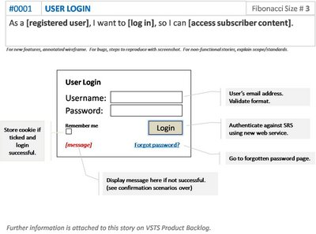
Example: Front of Card

Slide 10
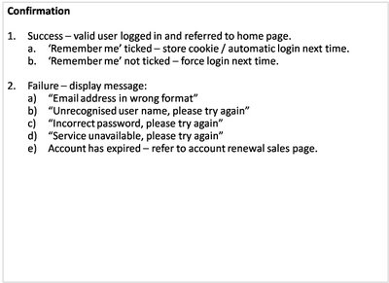
Example: Back of Card

Slide 11
How detailed should a User Story be?
Detailed enough
For the team to start working from
To establish further details and clarifications
at the time of development.

Slide 12
How detailed should a User Story be?
As customer I can log-in with my account, so I don’t have to re-enter my personal — information every time;
As customer I can review and confirm my order, so I can correct mistakes before I pay;
As customer I can pay for my order with a wire transfer, so that I can confirm my order;
As customer I can pay for my order with credit card, so that I can confirm my order;
As customer I receive a confirmation email with my order, so I have proof of my purchase; (acceptance criteria)
Notes:
For instance if there is a payment module of a shopping website one possible user story will be on payment. The examples above show how to split that one payment user story into multiple user stories based on multiple payment options. Last example 5 shows the acceptance criteria for this story. It is obvious that you want confirmation message after payment.

Slide 13
How is detail added to user stories?
Detail can be added to user stories in two ways:
By splitting a user story into multiple, smaller user stories.
By adding “conditions of satisfaction.”
Ex1: As a vice president of marketing, I want to select a holiday season to be used when reviewing the performance of past advertising campaigns so that I can identify profitable ones.
Detail could be added as:
Make sure it works with major retail holidays: Christmas, Easter, President’s Day, Mother’s Day, Father’s Day.
Holiday seasons can be set from one holiday to the next (such as Thanksgiving to Christmas).
Holiday seasons can be set to be a number of days prior to the holiday.

Slide 14
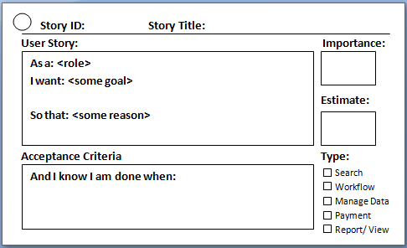
Notes:
User story Card

Slide 15
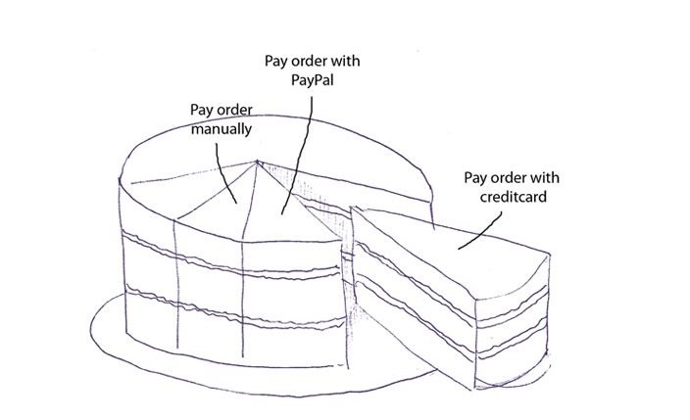
How to split a User Story into multiple user stories ?
A friendlier approach is to slice the cake up in vertical slices, each with a bit of cake, cream and fruit
Notes:
Take example of a online shopping website for which one major user story will be payment. So this cake shows how to slice user stories into sub stories so that each part has equal fruit and cream. So you can split that big payment user story into multiple stories based on payment options.

Slide 16
Splitting User story w.r.t business rules an example
As shop owner I can decline orders below 10 dollars, because they aren’t profitable;
As shop owner I can decline customers from outside the US, because the shipping expenses make these orders unprofitable;
As shop owner I can reserve ordered products from stock for 48 hours, so other customers see a realistic stock;
As shop owner I can automatically cancel orders for which I have not received payment within 48 hours, so I can sell them again to other customers;

Slide 17
INVEST in Good User Stories
Independent – User Stories should be as independent as possible.
Negotiable – a User Story is not a contract. It is not a detailed specification. It is a reminder of features for the team to discuss and collaborate to clarify the details near the time of development.
Valuable – User Stories should be valuable to the user (or owner) of the solution. They should be written in user language. They should be features, not tasks.
Estimatable – User Stories need to be possible to estimate. They need to provide enough information to estimate, without being too detailed.
Small – User Stories should be small. Not too small and not too big.
Testable – User Stories need to be worded in a way that is testable, i.e. not too subjective and to provide clear details of how the User Story will be tested.
Notes:
Criteria for writing a good user story

Slide 18
User Stories Summary
User Stories combine written and verbal communications, supported with a picture where possible.
User Stories should describe features that are of value to the user, written in the user’s language.
User Stories detail just enough information and no more.
Details are deferred and captured through collaboration
just in time for development.
Test cases should be written before development, when the User Story is written.
User Stories should be Independent, Negotiable, Valuable, Estimatable, Small and Testable.

